Slide 1
Travel Informers
Code Samples

Slide 2
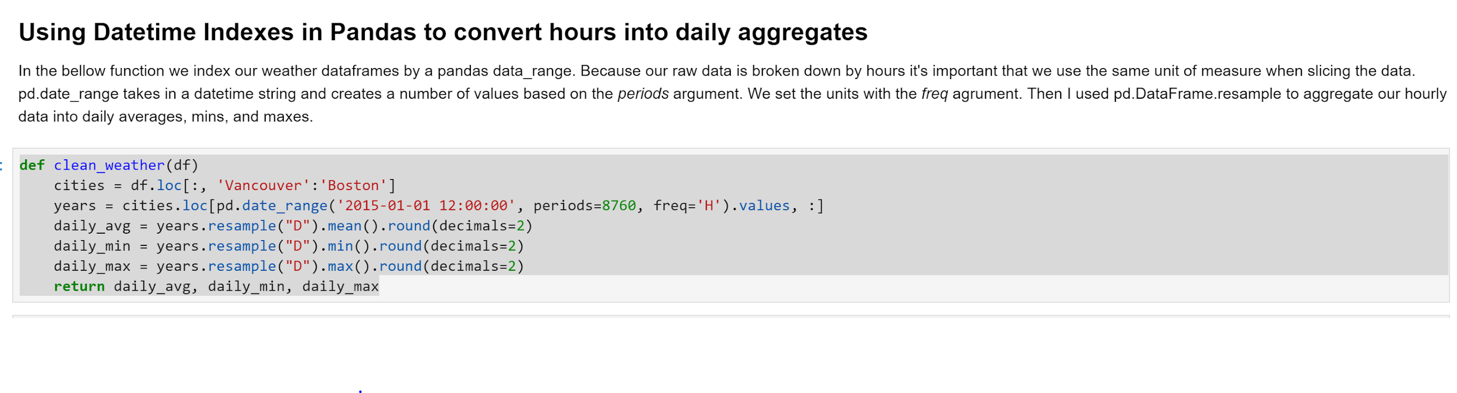
Date and Time can be a index
It’s handy

Slide 3
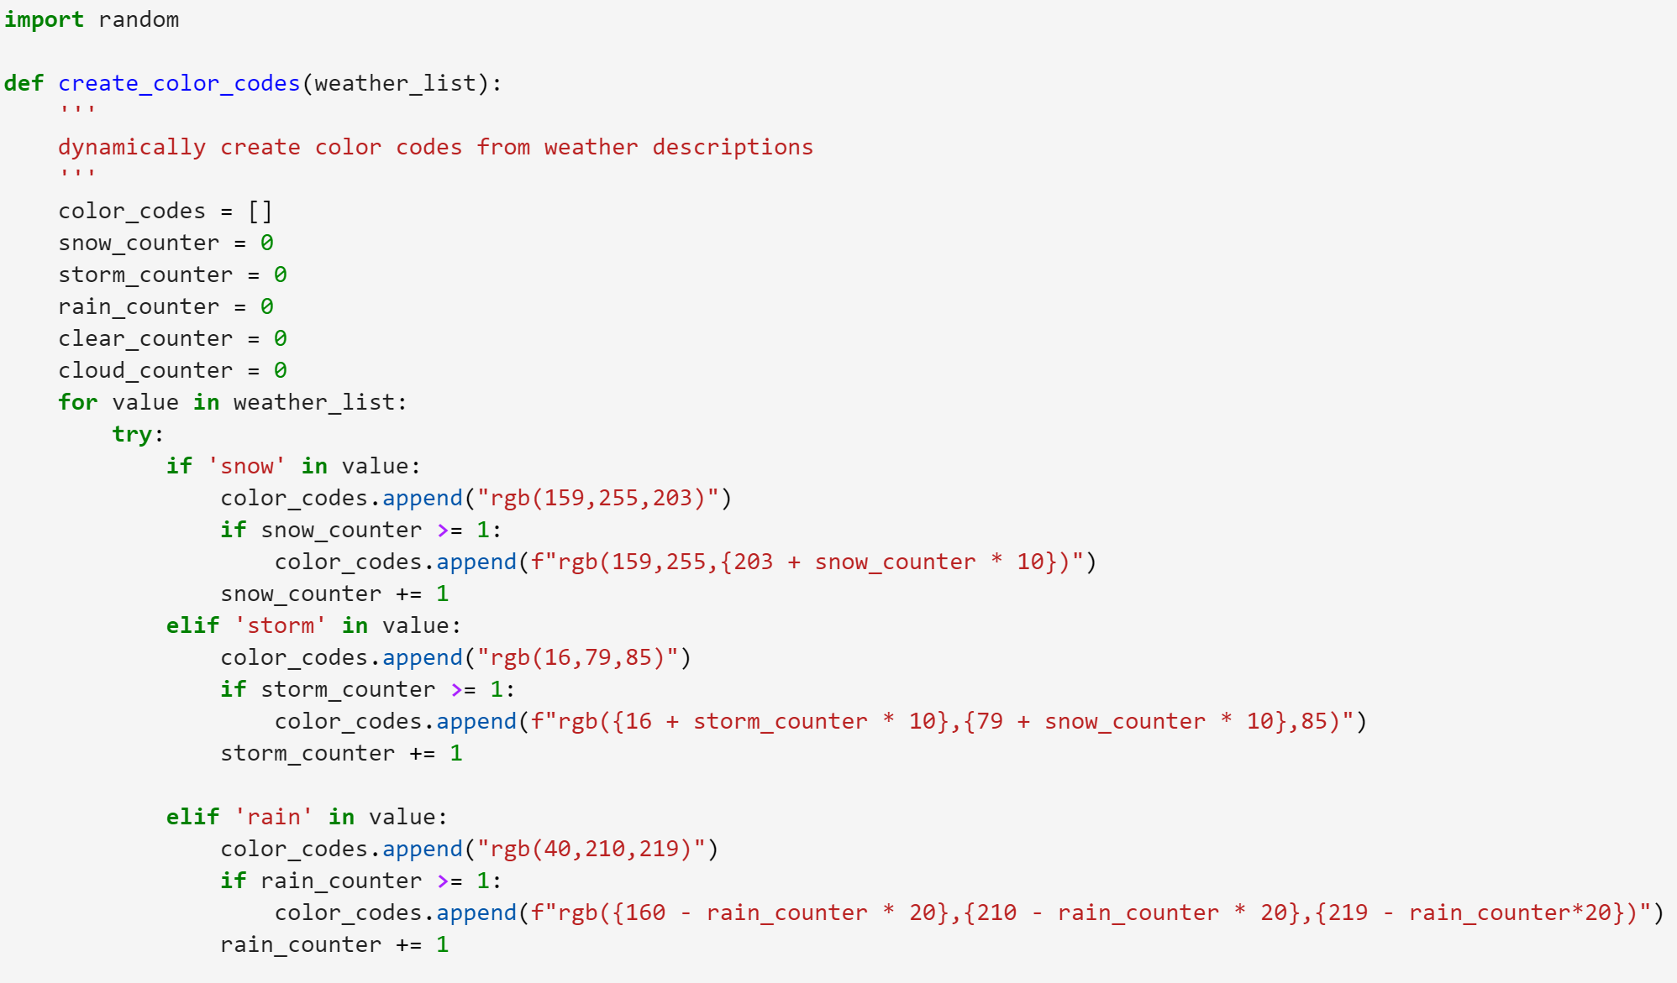
Creating color codes based on similar patterns

Slide 4
Setting up the backend, Plotly.react()
@app.route("/<city_name>/<month>/<x>")
def give_them_graphs(city_name, month, x):
traces = []
if (x == "temp"):
# but sqlalchemy is a bit funny with variable names and stuff, so...
foo = "Temperature"
x = ["Average Temperature", "Maximum Temperature", "Minimum Temperature"]
traces.append(sql_temp_timeseries_data(city_name, month, x))
# Then switch it back for the csvs to come
x = ["daily_avg_temps", "daily_max_temps", "daily_min_temps"]
elif (x == "wind"):
foo = "Wind Speed"
titles = ["Average Wind", "Maximum Wind", "Minimum Wind"]
x = ["daily_2015_avg_wind", "daily_2015_max_wind", "daily_2015_min_wind"]
traces.append(csv_timeseries_data(city_name, month, x, titles))
elif (x == "humidity"):
foo = "Humidity"
titles = ["Average Humidity", "Maximum Humidity", "Minimum Humidity"]
x = ["daily_2015_avg_humidity", "daily_2015_max_humidity", "daily_2015_min_humidity"]
traces.append(csv_timeseries_data(city_name, month, x, titles))
# traces.append(csv_timeseries_data(city_name, month, x)) # Doing this in SQL now, but just in case something breaks...
traces.append(csv_scatter_data(city_name, month, x))
traces.append(donut_data(city_name, month))
time_layout = {
'title': f'{foo} Over Time',
'xaxis': {
'tickangle': 90,
'autotick': False,
'tick0': 0,
'dtick': 3
},
'yaxis': {
'title': f'{foo}'
},
'autosize': True,
'plot_bgcolor': '#f1f1f1',
'paper_bgcolor': '#f1f1f1'
}
scatter_layout = {
'title': f'{foo} vs Number of Airport Delays',
'xaxis': {
'title': f'{foo}'
},
'yaxis': {
'title': 'Number of Airport Delays'
},
'autosize': True,
'plot_bgcolor': '#f1f1f1',
'paper_bgcolor': '#f1f1f1'
}
pie_layout = {
'title': f'Frequency of Weather Conditions in {city_name}',
'autosize': True,
'plot_bgcolor': '#f1f1f1',
'paper_bgcolor': '#f1f1f1'
}
traces.append(time_layout)
traces.append(scatter_layout)
traces.append(pie_layout)
return jsonify(traces)
temp_list = [Avg_temp, Max_temp, Min_temp]
def sql_temp_timeseries_data(city, month, files):
traces = []
colorlist = ['#aa00aa', '#ff4444', '#4444ff']
for i in range(3):
x = []
y = []
for row in session.query(getattr(temp_list[i], city), temp_list[i].datetime).filter(temp_list[i].datetime.like(f'%2015-{month}%')).all():
if (type(row[1]) == str):
time_converted = dt.datetime.strptime(row[1], '%Y-%m-%d')
x.append(time_converted)
elif (type(row[1] == dt.datetime)):
x.append(row[1])
y.append(float(row[0]))
trace = {
'x': x,
'y': y,
'type': 'scatter',
'name': city + " " + files[i],
'mode': 'lines',
'line': {'color': colorlist[i]}
}
traces.append(trace)
return traces
Notes:
Kevin: As the group leader, I managed our Git and made sure our project was cleanly running on Heroku with everybody’s functions integrated seamlessly. Additionally, I set up the flask app and back-end workings of our application. Here are two of the functions used, one using SQL calls to create a trace for Plotly, and the big one on the right which makes all of the traces and layouts and fun. Furthermore, I found that plotly.react(), according to the docs, is almost as fast as .restyle() and much much better than simply erasing and redrawing a plot with newplot(), which works great when you’re just having traces!

Slide 5
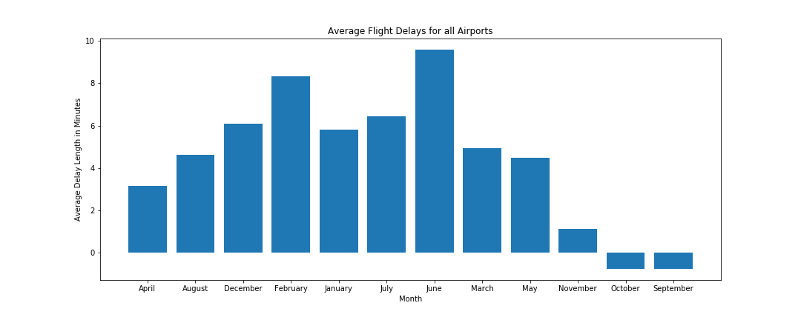
Preparing the Flight Delay Data

Slide 6
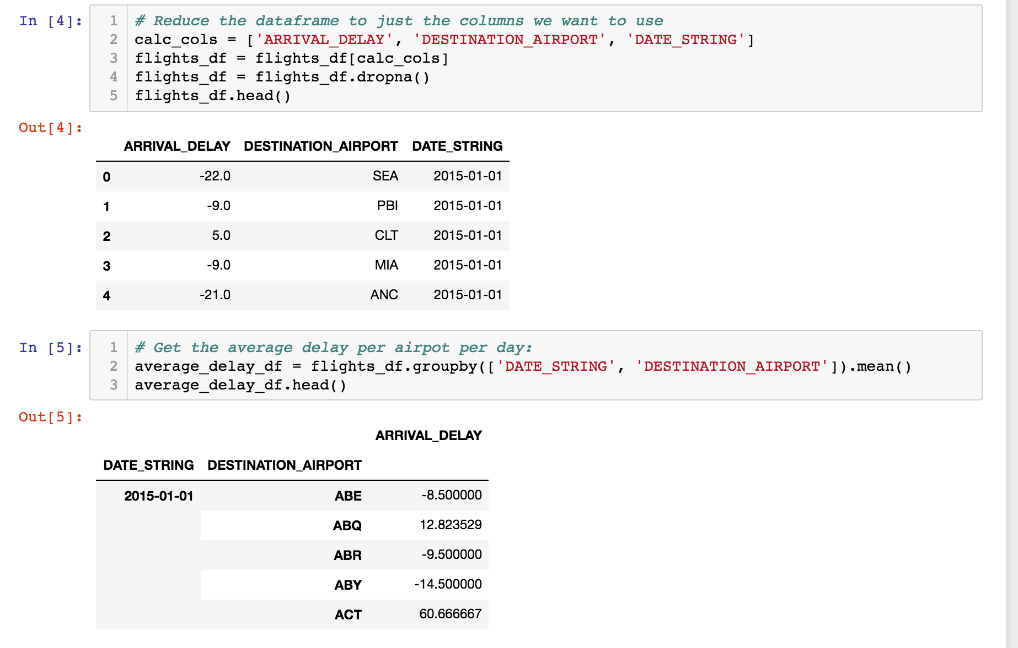

Slide 7
